Slide 1
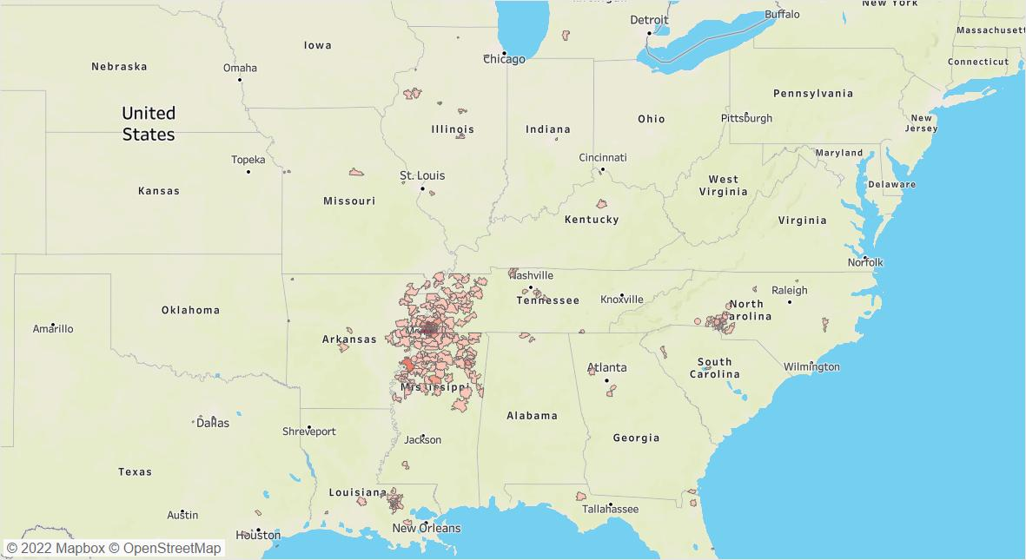


SCCRIP data sources include medical records at each site. Electronic medical record data are extracted and transferred via sFTP. Additional data are abstracted using REDCap.

Slide 2
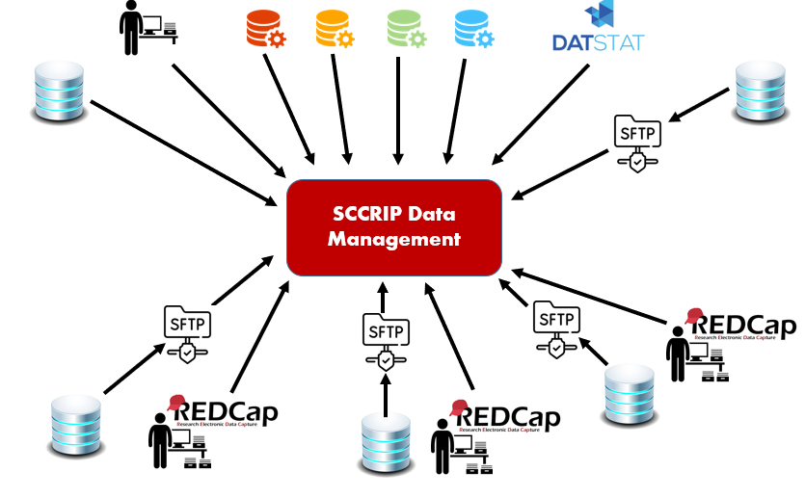
Data harmonization occurs annually. Data from all sources are brought into a data management environment and merged, cleaned, and validated. Data are made available to investigators who submit research concepts to the SCCRIP Scientific Review Committee.

Slide 3
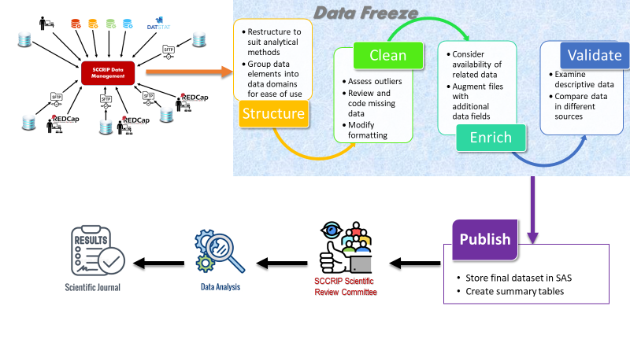
Data harmonization occurs annually. Data from all sources are brought into a data management environment and merged, cleaned, and validated. Data are made available to investigators who submit research concepts to the SCCRIP Scientific Review Committee.

